Slide 1
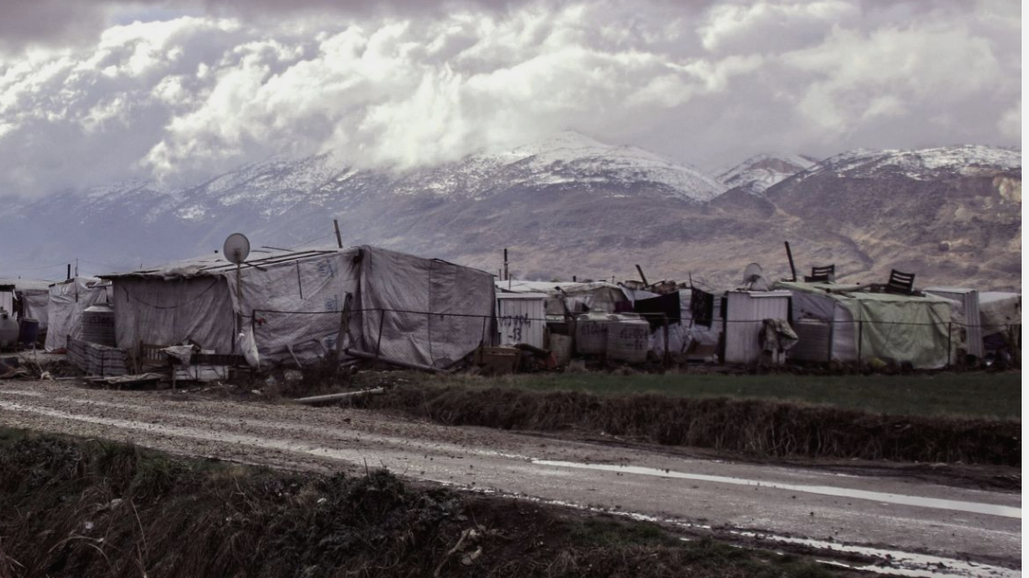
Refugee Return, Geopolitics and War Imaginaries
Refugee Hosts Conference
25 October 2019, University College London.
Dr. Tamirace Fakhoury
Lebanese American University

Slide 2
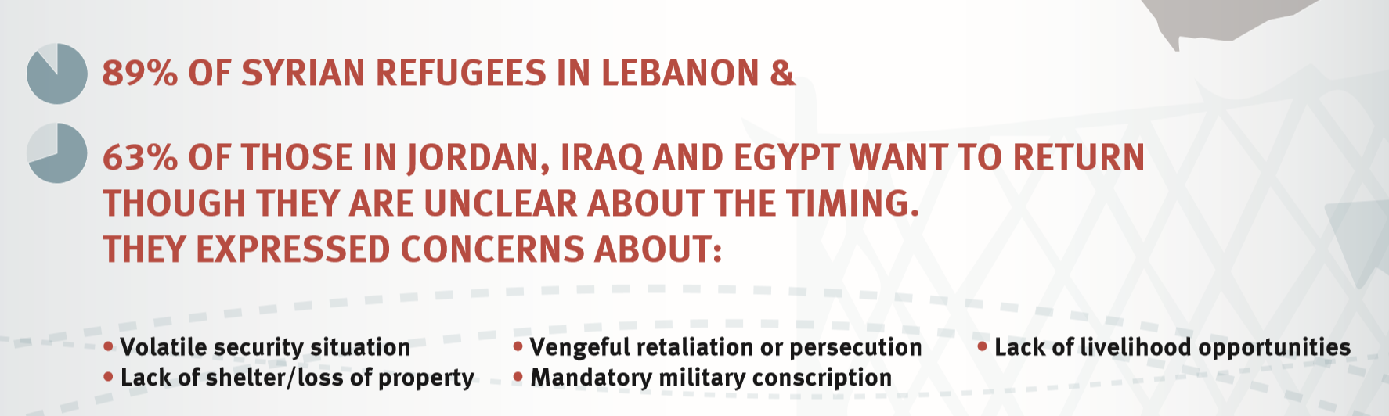
Syrian refugee return: are conditions favorable?
Source: #AUB4Refugees

Slide 3
Negotiating refugee rights in spaces of fragmentation and ambiguity.
Politics of refugee return: key site of contestation, bargaining leverage, and a "balance-of-power” game.

Slide 4
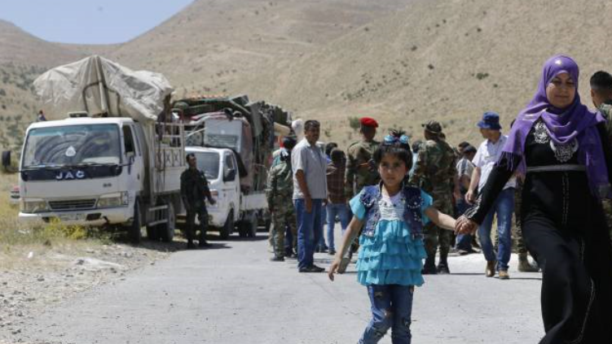
Key questions
how have some of Lebanon’s key governance actors cooperated and clashed on refugee return?
How have they capitalized on the politics of return to maximize their gains?
And how do their fragmented refugee return agendas paradoxically serve the authority of the state?

Slide 5
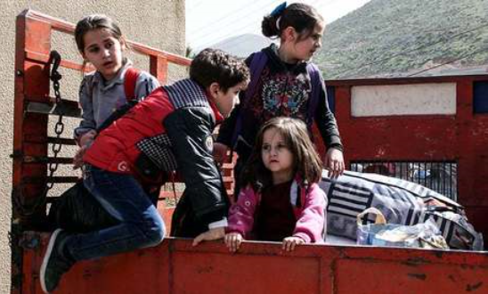
Structure
Mapping the proliferation of actors involved in return initiatives.
Exploring their conflicting preferences
Analysing motives rooted in war imaginaries, geopolitical interests and relationships of power

Slide 6
Backgrounder: Lebanon’s refugee system
A “sectarian-based model of politics” (Rogan 2009): political offices and appointments organized in accordance with sectarian criteria
Asylum system: highly fragmented with both formal and informal structures
Portrayal of refugees as a threat to Lebanon’s demographics and its sectarian power-sharing balance .

Slide 7
Lebanon’s policy frame
In the first years of the Syrian conflict, the Lebanese government has held an open-border policy, framing Syrians as “displaced” (Nazihin)
Since 2014, it has adopted more restrictive border and policy procedures.
In May 2015, the UNHCR suspended all registration
Currently, Lebanon is promoting a bold politics of refugee return
In this context, actors have developed various formal and informal refugee return channels (Fakhoury and Ozkul 2019)

Slide 8
A multitude of actors coordinating returns
Various formal and informal actors have embarked on refugee return initiatives.
General Security Offices (GSO) coordinate an official channel for Syrians to apply for voluntary returns.
Some political parties close to the Syrian regime have devised informal committees to process applications
Religious authorities have played a key role in legitimizing return initiatives

Slide 9
Conflicting preferences over the politics of refugee return
Lebanon’s key governance actors (pro-Syrian and anti-Syrian actors) disagree over the following issues:
The relationship with the Syrian regime (normalization of ties)
The actors that Lebanon is set to coordinate with
The conditions/temporalities underlying Syrian refugee return
International actors funding refugee stay in Lebanon.

Slide 10
What is at stake? Embedded motives and competing war imaginaries
The issue of refugee return cannot be separated from Lebanese actors’ “war imaginaries” and history of tensions with the Syrian regime.
In such imaginary constructs, the politics of Syrian refugee return has become closely tied to the fate of post-conflict Syria
Competing actors draw on refugee return as a strategic avenue to reinforce their alliances, secure their interests, and deploy authority in the shadow of Syria’s war.

Slide 11
What is at stake? Embedded motives and competing war imaginaries
Forming alliances and securing payoffs
Deploying authority and cementing power structures
Casting themselves as security managers, brokers and mediators

Slide 12
Are there benefits to informality and fragmentation?
Informality and fragmentation have yielded benefits to the Lebanese state
By shifting governance from central state institutions to other actors, the state evades pressures and obscures accountability

Slide 13
Concluding remarks
Conflicting refugee return agendas are to be read in the context of complex relationships of power, and competing war imaginaries
Competition and fragmentation over the politics of return serve the state’s governing logic.
The Lebanese case generates broader insights into how responses to displacement are shaped in informal, hybrid and ambiguous spaces.

Slide 14
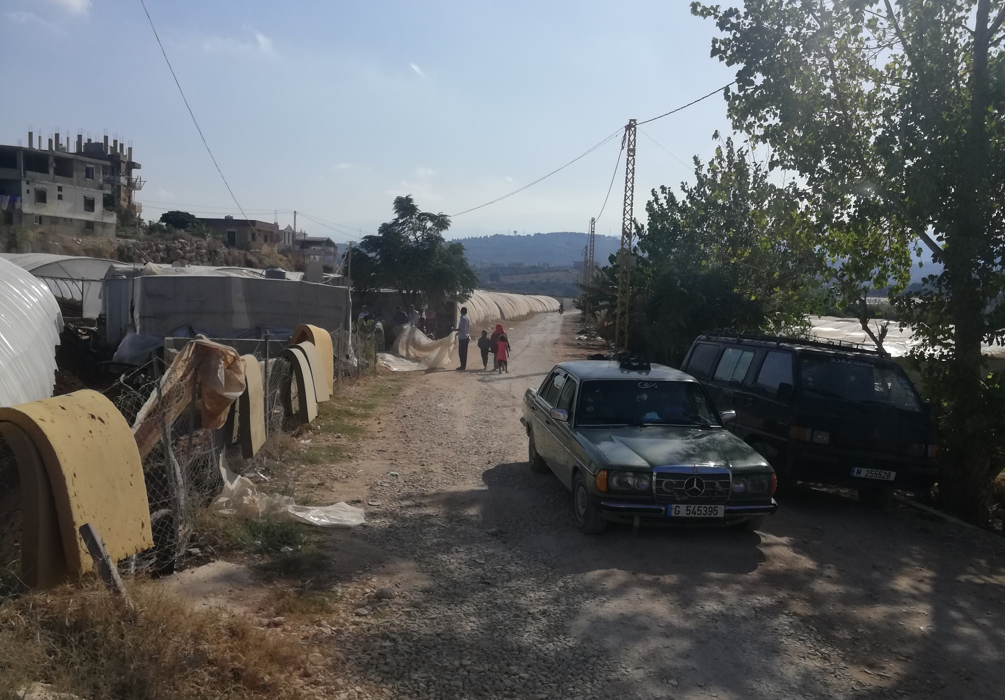
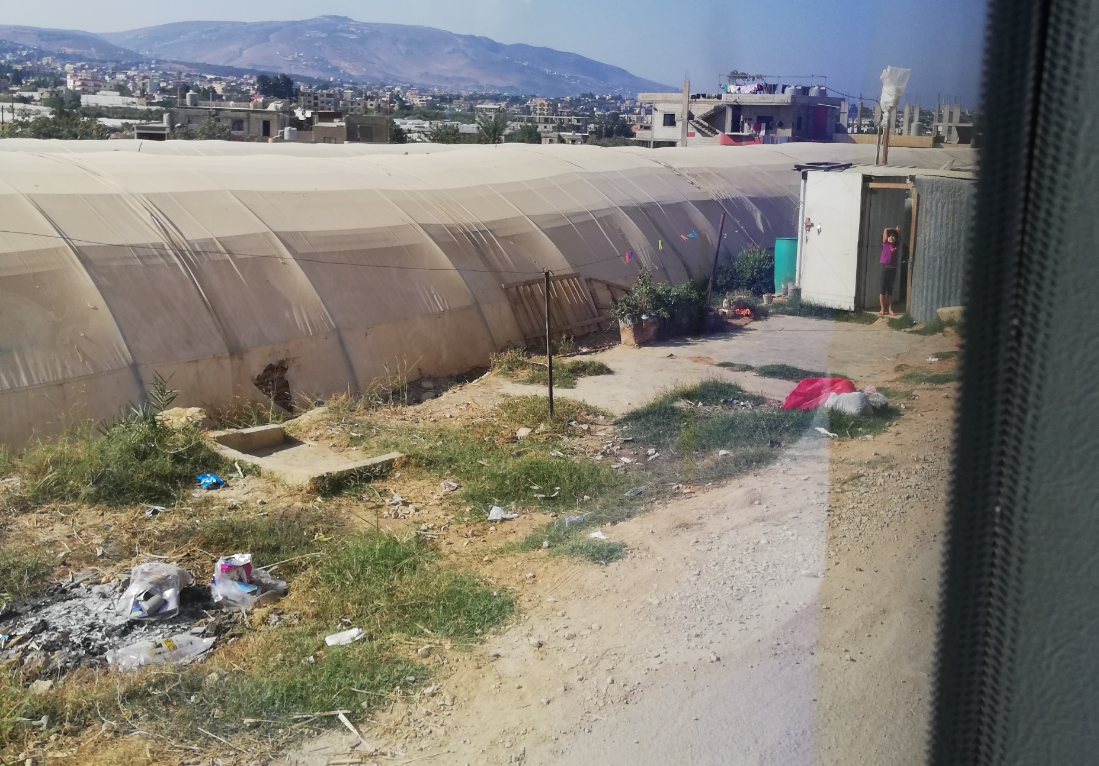
Thank you!

Slide 15
“I want to head to Syria so that the Syrian people can return, the same way its army returned,” says Foreign Minister Gebrane Bassil to his supporters. Source: Daily Star

