Slide 1
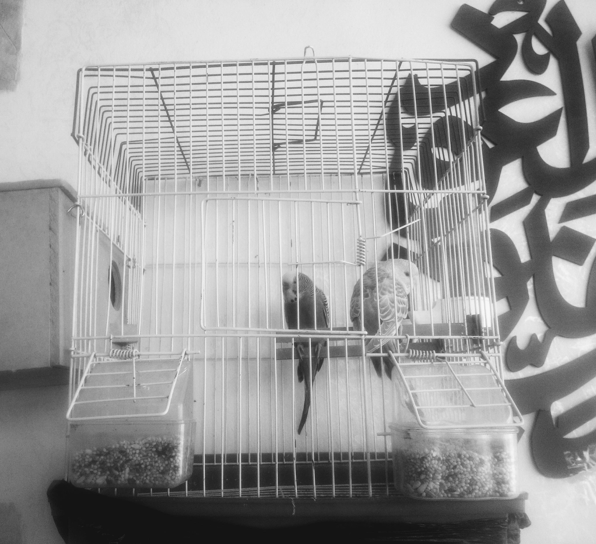
Acts of ‘homing’ in the Eastern Desert How Syrian refugees make temporary homes in a village outside Zaatari Camp, Jordan
Dr Ann Wagner, Lecturer in Anthropology of Development, University of Edinburgh

Slide 2
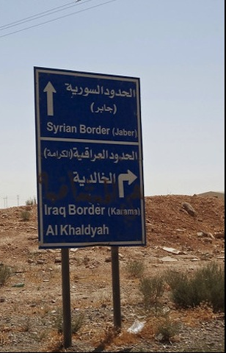
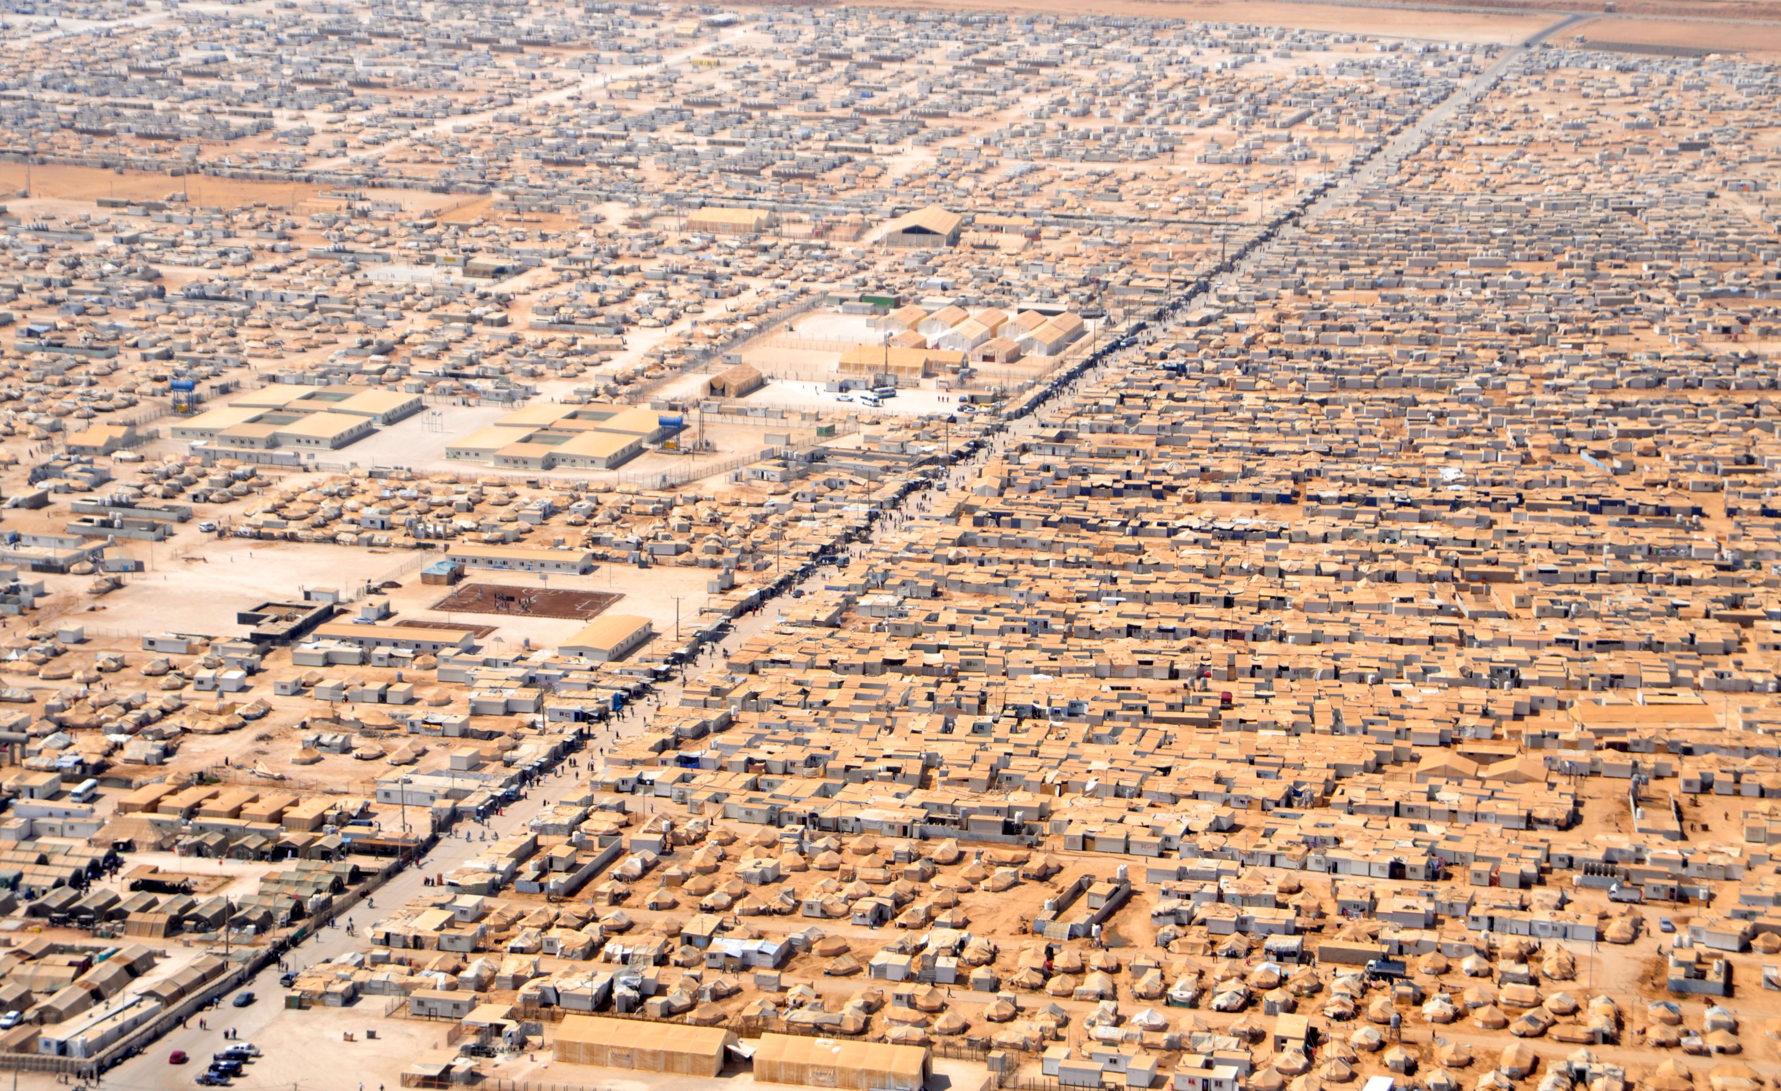
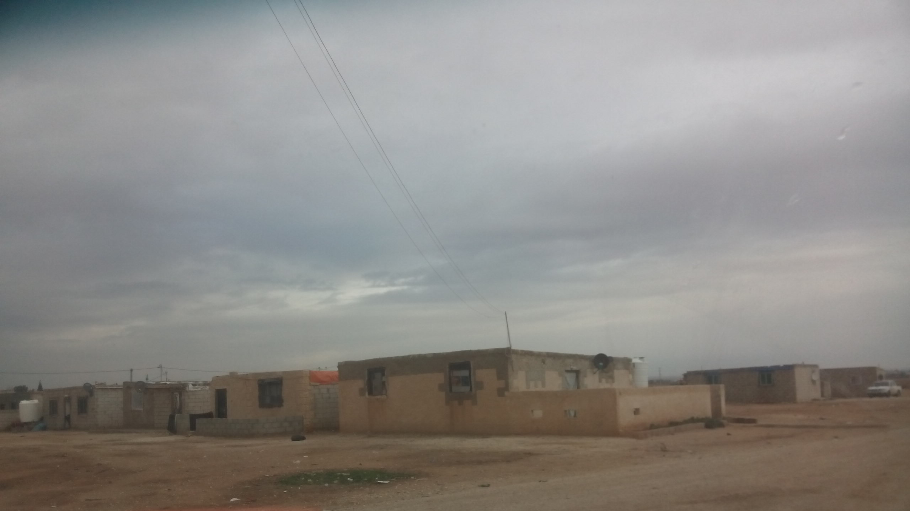
On the other side of the fence
Notes:
Inlcude satellite images of Zaatari camp
Home to 12,000 Jordanians and 3,800-4,500 Syrians (Weiner 2014)
What is the puzzle:
Although they live on the doorstep of Zaatari camp, Jordan’s most important humanitarian hub, they receive hardly any assistance and go under the radar of NGOs; instead, they get by by working in the informal economy
They have received land and started building houses -are they planning to stay?

Slide 3
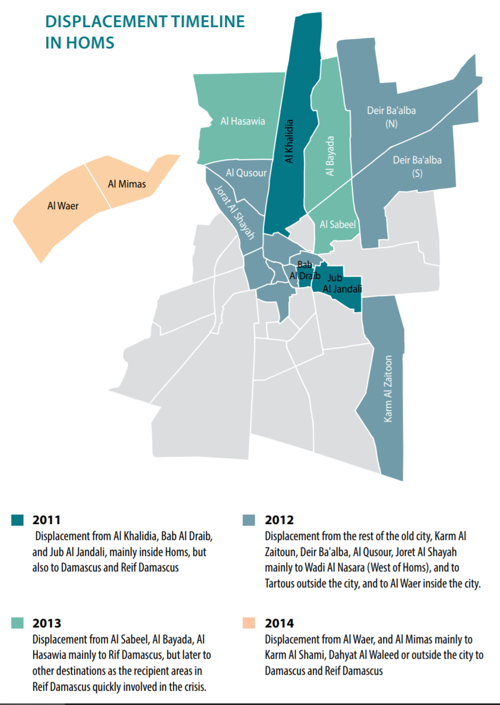
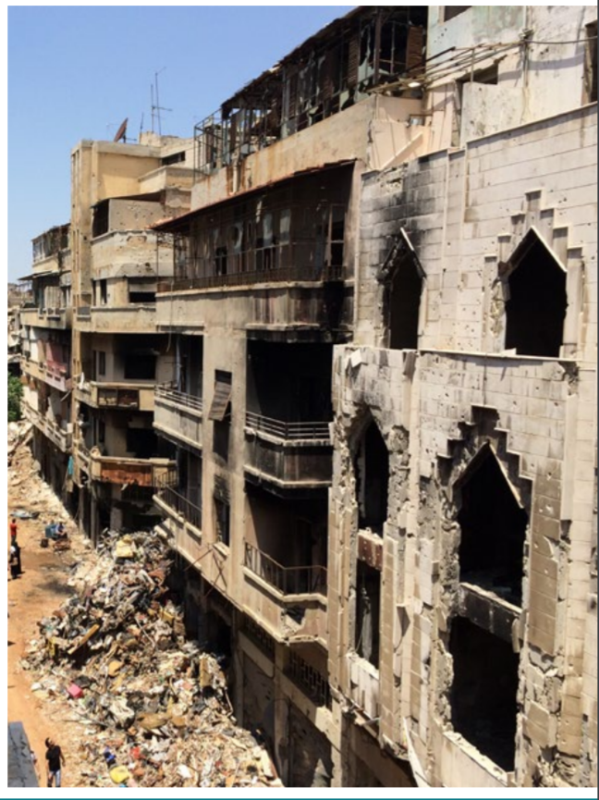
A story about war?
UN HABITAT 2014
Notes:
Half a million people displaced by Dec 2013; more than 50% of housing habitat destroyed

Slide 4
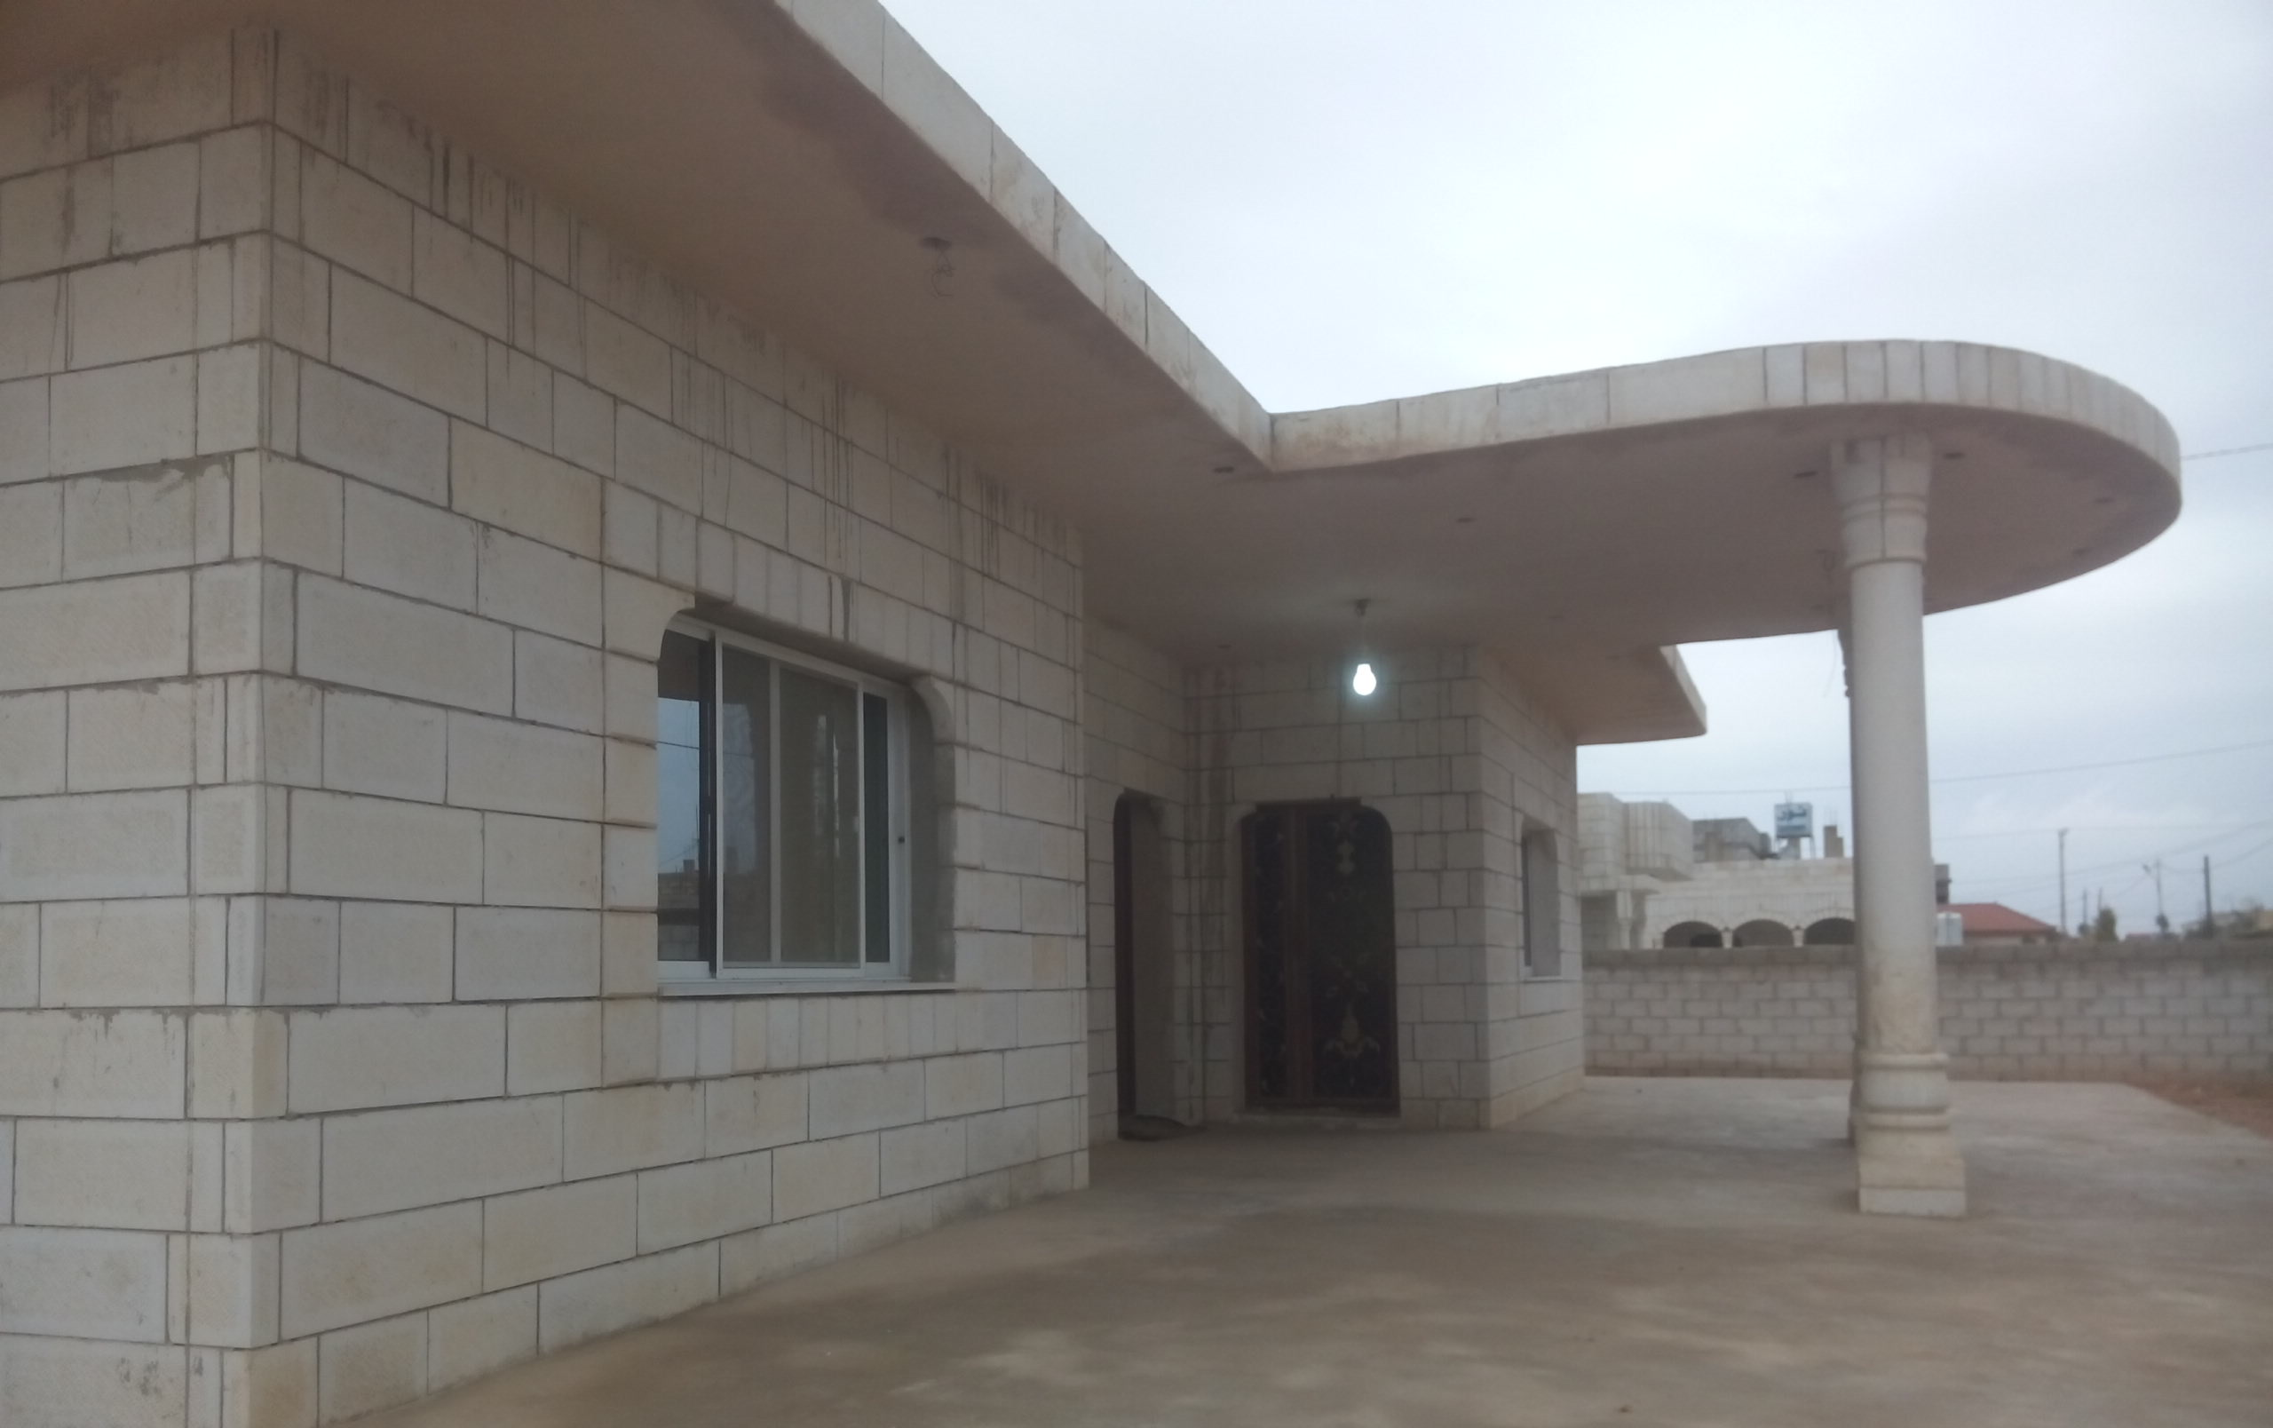
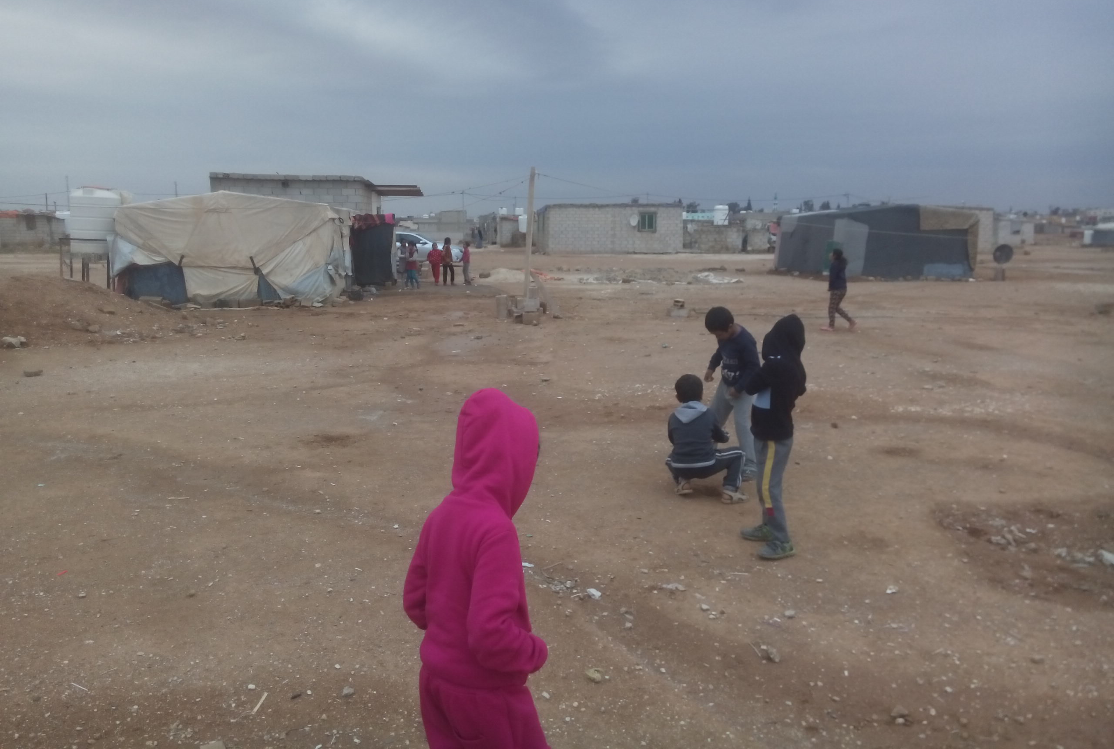
A story about war?
But also about…
Guests.
Tribesmen.
“Here is different [from nearby Mafraq]. We are all relatives.“
Labour migrants.
Land as a commodity?
“In five years, they‘ll go back.“ (Jordanian landowner, late 2016)
Notes:
Community-building:
Between Syrians and Jordanians
Entering the country: bypassing Zaatari Camp; received land from their relatives
Among Syrians >> e.g. built a house for a widow
Labour migration: since the 1980s; gendered; many of the men had worked in Zaatari village before the war; for women, it‘s usually the first time in Jordan
Backstory: Jordan as a rentier state, outsourcing of low-skilled labour and hostile immigration policies
Emergence of a proper housing market in Mandate Times under British rule (in the 1930s)

Slide 5
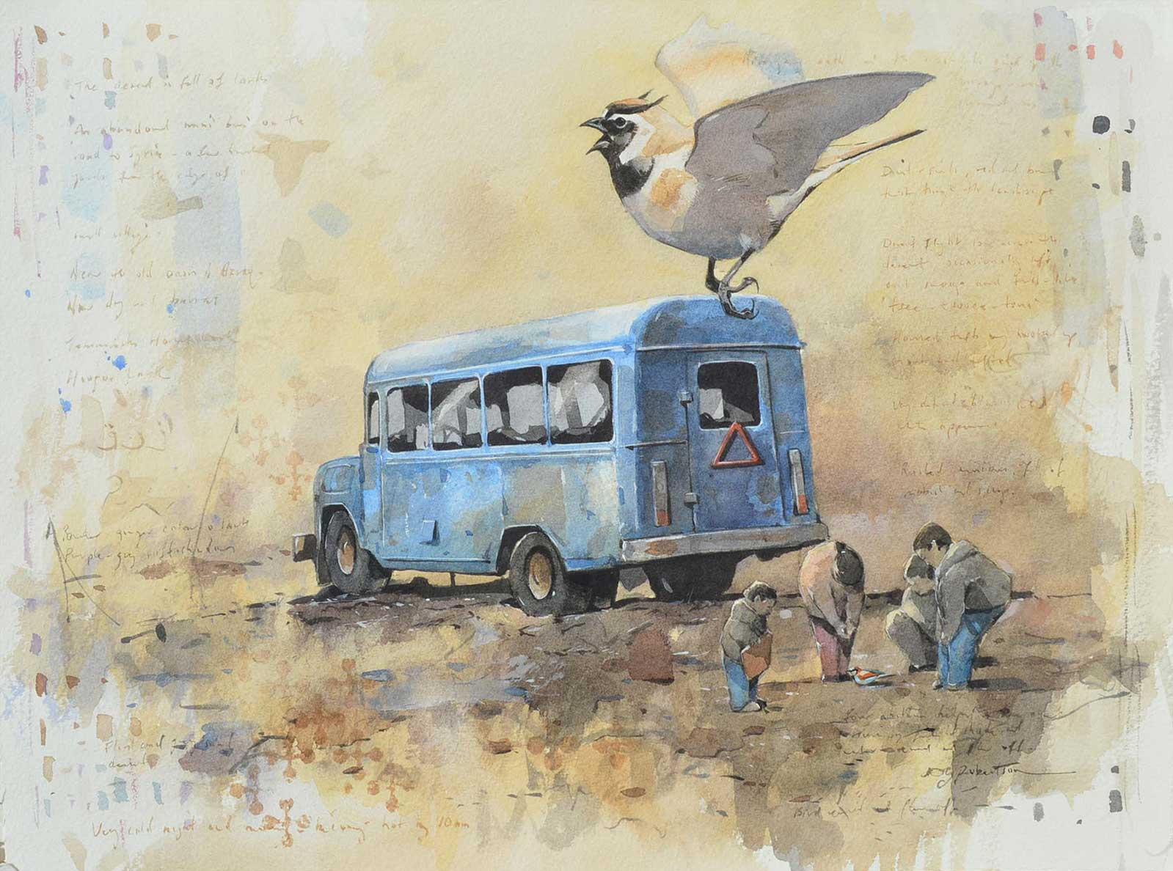
Derek Robertson, "The Desert is Full of Promises"
Notes:
Derek drawing

