Slide 1

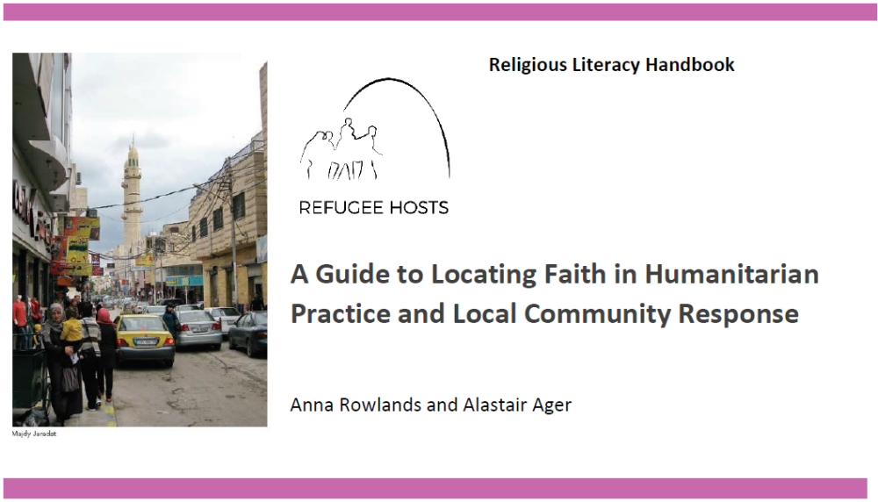

Locating Faith in Humanitarian Practice and Local Community Response
Chairs and Facilitators: Anna Rowlands, Refugee Hosts and Durham University and Alastair Ager. Refugee Hosts and Queen Margaret University, Edinburgh

Slide 2
A GUIDE TO LOCATING faITH IN HUMANITARIAN PRACTICE AND LOCAL community RESPONSE
The following claims are foundational to the Handbook:
The ubiquity of belief
Religion as contextual and non-exceptional
The relevance of time as well as space.
The importance of humanitarian action being informed by wider contextual analysis

Slide 3
A GUIDE TO LOCATING faITH IN HUMANITARIAN PRACTICE AND LOCAL community RESPONSE
We view religion, variously, as:
An everyday part of identities and systems of meaning for displaced persons and for host communities
A causal factor in conflicts and displacement
A system of formal and informal humanitarian care and response
A system of cultural meaning making, with texts, traditions and practices which shape response to trauma and provide sources for interpretation, resistance and healing, and which shape views of the meaning of time, space and place.
We view the strengths of LFAs as humanitarian actors as rooted in:
Longevity of presence in communities, including a commitment to future presence
Established relationships of trust that LFAs have in localities
Benefits of scale: LFA often have capacities for deep, slow accompaniment work that larger organisations lack as well as quick response to immediate material need.
The specific capacities and expertise that faith based groups have developed over time and are able to offer to communities, in our interviews FBOs and LFAs felt that their expertise related to relationship building, education and psychosocial care especially and the capacity to build common projects between refugees and local hosts over time.
With opportunities come challenges:
LFAs can exclude as well as embrace; LFAs have their peripheries and margins too.
Informal leadership can be as important as formal and this can be harder to identify
The time and relationship building capacities of smaller scale LFAs can act as a limitation when the scale of need is so high; there is often understandable resistance to scaling up LFAs operations
The primary function of a LFA is not typically humanitarian, although usually includes some facet of the humanitarian.
It is often difficult for LFA to meet various standards and protocols that are set by actors outside of the context. This limits opportunity to bid for funds and to manage monitoring and evaluation.
The values framework that comes with working with large secular INGOs can be a barrier to collaboration with LFAs. This can be about perceptions and misperceptions on both sides. Mutual literacy in worldviews and core values can be low.

Slide 4
A GUIDE TO LOCATING faITH IN HUMANITARIAN PRACTICE AND LOCAL community RESPONSE
_____________
Governmental and Political Context
____________
___________
Global Humanitarian Regime
___________
Shapes public and private space for religious expression, engagement & narrative
Enforces secular framing on humanitarian strategy and engagement
Religious belief, self-understanding & institutional capacity drives forms of engagement
___________
Religious Civil Society
___________
____________
Secular Groups in Civil Society
____________
Secular principles and institutional capacity drives forms of engagement
Religious belief and affiliation shapes provision of welcome and solidarity
________
Hosts
________
________
Refugees
________
Religious belief and affiliation shapes experience of exile and loss and narratives of agency and resilience

Slide 5

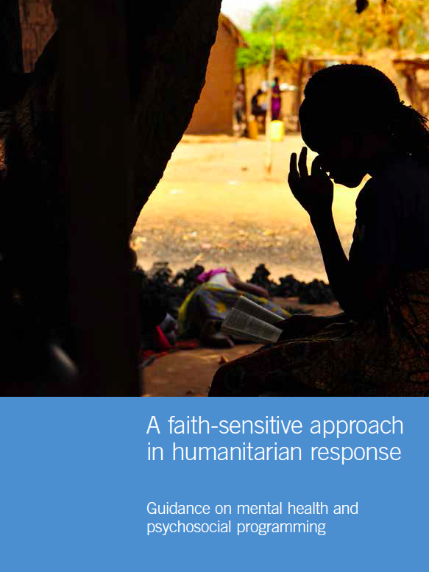

A GUIDE TO LOCATING faITH IN HUMANITARIAN PRACTICE AND LOCAL community RESPONSE
Humanitarianism and the
privatization
marginalisation
instrumentalisation
of religion
_____________
Governmental and Political Context
____________
___________
Global Humanitarian Regime
___________
Shapes public and private space for religious expression, engagement & narrative
Enforces secular framing on humanitarian strategy and engagement
Religious belief, self-understanding & institutional capacity drives forms of engagement
___________
Religious Civil Society
___________
____________
Secular Groups in Civil Society
____________
Documenting religion is an active and effective source of coping in many humanitarian contexts
Secular principles and institutional capacity drives forms of engagement
Religious belief and affiliation shapes provision of welcome and solidarity
________
Hosts
________
________
Refugees
________
Religious belief and affiliation shapes experience of exile and loss and narratives of agency and resilience

Slide 6
A GUIDE TO LOCATING faITH IN HUMANITARIAN PRACTICE AND LOCAL community RESPONSE
_____________
Governmental and Political Context
____________
___________
Global Humanitarian Regime
___________
Shapes public and private space for religious expression, engagement & narrative
Enforces secular framing on humanitarian strategy and engagement
Religious belief, self-understanding & institutional capacity drives forms of engagement
___________
Religious Civil Society
___________
____________
Secular Groups in Civil Society
____________
Secular principles and institutional capacity drives forms of engagement
Religious belief and affiliation shapes provision of welcome and solidarity
________
Hosts
________
________
Refugees
________
Religious belief and affiliation shapes experience of exile and loss and narratives of agency and resilience

Slide 7
Locating Faith in Humanitarian Practice and Local Community Response
Refugee Narratives
“We keep to ourselves now. We are much less ‘alive’ than we used to be. I have to say I pray to God that this country is protected”
“I pray at the community's mosque down the street. It's a spiritual space. It emphasizes a number of important values such as brotherhood, love, and equality. We all kneel to the same God, We are equal in front of him. Rich, poor, Jordanian, Syrian, Indian…and in front God we all belong to our Islam. We all have an identity and we are all the same. The mosque has brought me closer to the people in the neighbourhood.”
“We were encouraged to help the refugees coming to Daraa because our humanity prompted us to do so. There is a religious saying ‘Khairkom le ahleh’ and another ‘Al muslim kal jasad al wahed’ meaning that all Arabs and Muslims are one and therefore we need to help one another and stand up for each other at times of necessity.”
[Field Notes Jordan, 2018]

Slide 8
Locating Faith in Humanitarian Practice and Local Community Response
Refugee Narratives
Most of the time I said God is not with us, because all of this has happened to us…Sometimes, I say my lord I didn’t do anything wrong why you are punishing me? From all sides, like: I lost my family, my husband is not good with me and I have a sick daughter….(I think about the anger with Allah) if I am sad. So, when problems happen...I say my lord why are you doing this to me?...I still pray and fast, thank God for that…I can’t (live) without praying. If I don’t pray, I feel like I lost something.
[Kathleen Rutledge, Field notes, Northern Iraq]

Slide 9
A GUIDE TO LOCATING faITH IN HUMANITARIAN PRACTICE AND LOCAL community RESPONSE
_____________
Governmental and Political Context
____________
___________
Global Humanitarian Regime
___________
Shapes public and private space for religious expression, engagement & narrative
Enforces secular framing on humanitarian strategy and engagement
Religious belief, self-understanding & institutional capacity drives forms of engagement
___________
Religious Civil Society
___________
____________
Secular Groups in Civil Society
____________
Secular principles and institutional capacity drives forms of engagement
Religious belief and affiliation shapes provision of welcome and solidarity
________
Hosts
________
________
Refugees
________
Religious belief and affiliation shapes experience of exile and loss and narratives of agency and resilience

Slide 10
Locating Faith in Humanitarian Practice and Local Community Response
Hosting Narratives
Reference was commonly made to the hadith in the Qu’ran that talks of the Prophet being hosted in the town of Medina when seeking refuge. One young woman in Jerash reflected on how her school teacher had addressed discrimination and conflicts in the initial period of migration:
“She reminded us when the Prophet - peace be upon him - emigrated to Al Madinah and how the people of Al-Madinah welcomed them and shared everything with them. After that, we felt ashamed that we treated them in this way.”
Christian interviewees also drew on sacred scripture to explain the moral basis for engaging with refugees. A church leader in Irbid engaged in supporting food distributions to Syrian refugees reported:
“We are explicitly instructed in the Bible ‘Do not forget to do good and to share with others’”
[Field Notes Jordan, 2014 and 2018]

Slide 11
Locating Faith in Humanitarian Practice and Local Community Response
Hosting Narratives
Religious interpretation was not only used to underpin perceived obligation for hosting but also as a basis to consider its limits. These varied widely:
“There is a hadith ‘the believers – in their mutual kindness, compassion and sympathy – are as one body. When one of the limbs suffers, the whole body responds to it with wakefulness and fever’. It is important to note that the Prophet said believers not just Muslims. Anyone who believes should receive kindness, compassion and sympathy. Even if he is Buddhist!”
“Religion has always instructed us to host those in need especially if we have language and religion in common”.
“It’s important to note that the people of Mecca didn’t overstay their welcome. They were hosted temporarily until they were able to get their lives in order and become independent”.

Slide 12
A GUIDE TO LOCATING faITH IN HUMANITARIAN PRACTICE AND LOCAL community RESPONSE
_____________
Governmental and Political Context
____________
___________
Global Humanitarian Regime
___________
Shapes public and private space for religious expression, engagement & narrative
Enforces secular framing on humanitarian strategy and engagement
Religious belief, self-understanding & institutional capacity drives forms of engagement
___________
Religious Civil Society
___________
____________
Secular Groups in Civil Society
____________
Secular principles and institutional capacity drives forms of engagement
Religious belief and affiliation shapes provision of welcome and solidarity
________
Hosts
________
________
Refugees
________
Religious belief and affiliation shapes experience of exile and loss and narratives of agency and resilience

Slide 13
A GUIDE TO LOCATING faITH IN HUMANITARIAN PRACTICE AND LOCAL community RESPONSE
_____________
Governmental and Political Context
____________
___________
Global Humanitarian Regime
___________
Shapes public and private space for religious expression, engagement & narrative
Enforces secular framing on humanitarian strategy and engagement
Religious belief, self-understanding & institutional capacity drives forms of engagement
___________
Religious Civil Society
___________
____________
Secular Groups in Civil Society
____________
Secular principles and institutional capacity drives forms of engagement
Religious belief and affiliation shapes provision of welcome and solidarity
________
Hosts
________
________
Refugees
________
Religious belief and affiliation shapes experience of exile and loss and narratives of agency and resilience

Slide 14
A GUIDE TO LOCATING faITH IN HUMANITARIAN PRACTICE AND LOCAL community RESPONSE
_____________
Governmental and Political Context
____________
___________
Global Humanitarian Regime
___________
Shapes public and private space for religious expression, engagement & narrative
Enforces secular framing on humanitarian strategy and engagement
Religious belief, self-understanding & institutional capacity drives forms of engagement
___________
Religious Civil Society
___________
____________
Secular Groups in Civil Society
____________
Secular principles and institutional capacity drives forms of engagement
Religious belief and affiliation shapes provision of welcome and solidarity
________
Hosts
________
________
Refugees
________
Religious belief and affiliation shapes experience of exile and loss and narratives of agency and resilience

Slide 15
A GUIDE TO LOCATING faITH IN HUMANITARIAN PRACTICE AND LOCAL community RESPONSE
_____________
Governmental and Political Context
____________
___________
Global Humanitarian Regime
___________
Shapes public and private space for religious expression, engagement & narrative
Enforces secular framing on humanitarian strategy and engagement
Religious belief, self-understanding & institutional capacity drives forms of engagement
___________
Religious Civil Society
___________
____________
Secular Groups in Civil Society
____________
Secular principles and institutional capacity drives forms of engagement
Religious belief and affiliation shapes provision of welcome and solidarity
________
Hosts
________
________
Refugees
________
Religious belief and affiliation shapes experience of exile and loss and narratives of agency and resilience

Slide 16
A GUIDE TO LOCATING faITH IN HUMANITARIAN PRACTICE AND LOCAL community RESPONSE
_____________
Governmental and Political Context
____________
___________
Global Humanitarian Regime
___________
Shapes public and private space for religious expression, engagement & narrative
Enforces secular framing on humanitarian strategy and engagement
Religious belief, self-understanding & institutional capacity drives forms of engagement
___________
Religious Civil Society
___________
____________
Secular Groups in Civil Society
____________
Secular principles and institutional capacity drives forms of engagement
Religious belief and affiliation shapes provision of welcome and solidarity
________
Hosts
________
________
Refugees
________
Religious belief and affiliation shapes experience of exile and loss and narratives of agency and resilience

Slide 17
A GUIDE TO LOCATING faITH IN HUMANITARIAN PRACTICE AND LOCAL community RESPONSE
_____________
Governmental and Political Context
____________
___________
Global Humanitarian Regime
___________
Shapes public and private space for religious expression, engagement & narrative
Enforces secular framing on humanitarian strategy and engagement
Religious belief, self-understanding & institutional capacity drives forms of engagement
___________
Religious Civil Society
___________
____________
Secular Groups in Civil Society
____________
Secular principles and institutional capacity drives forms of engagement
Religious belief and affiliation shapes provision of welcome and solidarity
________
Hosts
________
________
Refugees
________
Religious belief and affiliation shapes experience of exile and loss and narratives of agency and resilience

Slide 18
A GUIDE TO LOCATING faITH IN HUMANITARIAN PRACTICE AND LOCAL community RESPONSE
_____________
Governmental and Political Context
____________
___________
Global Humanitarian Regime
___________
Shapes public and private space for religious expression, engagement & narrative
Enforces secular framing on humanitarian strategy and engagement
Religious belief, self-understanding & institutional capacity drives forms of engagement
___________
Religious Civil Society
___________
____________
Secular Groups in Civil Society
____________
Secular principles and institutional capacity drives forms of engagement
Religious belief and affiliation shapes provision of welcome and solidarity
________
Hosts
________
________
Refugees
________
Religious belief and affiliation shapes experience of exile and loss and narratives of agency and resilience

Slide 19
A GUIDE TO LOCATING faITH IN HUMANITARIAN PRACTICE AND LOCAL community RESPONSE
_____________
Governmental and Political Context
____________
___________
Global Humanitarian Regime
___________
Shapes public and private space for religious expression, engagement & narrative
Enforces secular framing on humanitarian strategy and engagement
Religious belief, self-understanding & institutional capacity drives forms of engagement
___________
Religious Civil Society
___________
____________
Secular Groups in Civil Society
____________
Secular principles and institutional capacity drives forms of engagement
Religious belief and affiliation shapes provision of welcome and solidarity
________
Hosts
________
________
Refugees
________
Religious belief and affiliation shapes experience of exile and loss and narratives of agency and resilience

