Slide 1
Welcome and Opening Remarks
Prof. Elena Fiddian-Qasmiyeh
Professor of Migration and Refugee Studies, UCL
Principal Investigator, Refugee Hosts

Slide 2
Refugee Hosts Team
Prof. Elena Fiddian-Qasmiyeh, UCL (PI)
Prof. Alastair Ager, Queen Margaret University-Edinburgh (Co-I)
Prof. Lyndsey Stonebridge, Birmingham University (Co-I)
Dr. Anna Rowlands, Durham University (Co-I)
Yousif M. Qasmiyeh, Oxford University (Writer-in-Residence)
Dima Hamadmad, Rahmeh Abu-Shweimeh, Dr. Rana Dajani, Rania Al-Saheb, Shatha Al-Nakib, Sura Al-Mahasis
  research in Amman, Irbid (city and camp), Jarash and Zarqaa in Jordan
Bayan Itani, Hanna Dahdal, Reem El-Khatib, Leonie Harsh, Mohammad Abu Iyad
  research in Hamra (Beirut), Baddawi refugee camp, and the Jebel al-Baddawi neighbourhood in Lebanon
Leonie Harsh and Paladia Ziss
  research in Berlin and Frankfurt, Germany
Aydan Greatrick and Sorcha Daly, UCL

Slide 3
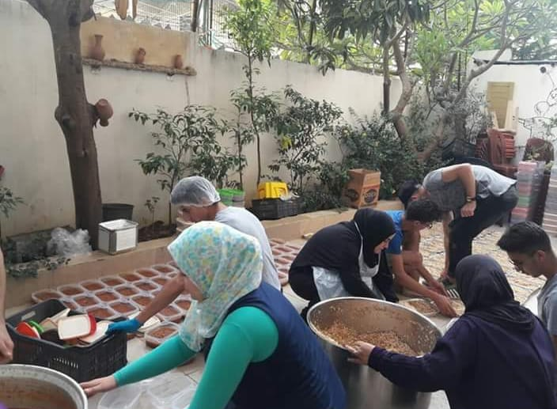
How, why and with what effect are local communities, including established refugee communities, in Lebanon, Jordan and Turkey responding to displacement from Syria?
A Syrian coffee vendor in Baddawi camp, Lebanon
Baddawi camp residents preparing iftar baskets for distribution in the camp
Notes:
Starting from the acknowledgement that local communities (incl. communities of faith and refugee communities), are key providers of assistance and protection to refugees, this project explores
How, why and with what effect local communities in Lebanon, Jordan & Turkey are responding to displacement from Syria?

Slide 4
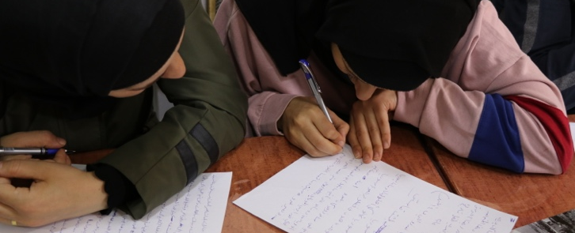
Project Partners:
  PEN International and English-PEN
  Joint Learning Initiative on Local Faith Communities and Refugees
Project Collaborators:
  Stories in Transit
  Save the Children’s Humanitarian Affairs Team

Slide 5
Project and Conference Principles
Challenging exceptionalist framing and presentist bias of refugee studies and policies
Examining responses to displacement from Syria in relation to – rather than isolation from – other geographical and historical situations
Engaging with the politics of knowledge production and circulation
Identifying and resisting structural barriers

